Slide 1
Welcome! Workshop 1: Strategy
7002 CRB
Professional Management Development – Consultancy

Slide 2

Activity 1: People Bingo - getting to know each other….

Slide 3
Workshop Learning Outcomes
At the end of this workshop, you should be able to:
Discuss the module structure and content
Understand the assessment requirements
Discuss the role of a consultant
Understand the factors involved in strategic positioning
Consider the value and appropriate use of key strategic tools
Notes:
T

Slide 4
CLIENT
CLARITY
CREATE
CHANGE
CONFIRM
CONTINUE
CLOSE
WORKSHOP 1:
Analyse client Needs
Organisational Strategy
WORKSHOP 2:
Leadership Styles
Culture, values, legal, ethical environment
WORKSHOP 3:
Creative Thinking
WORKSHOP 4:
Managers as Effective Leaders
Communication Tools
WORKSHOP 1: Key Concepts
The role of the consultant
Assessing clients’ needs
Strategic position
Performance management
WORKSHOP 2: Key concepts
Leaders vs Managers
Transformational, transactional and situational leadership styles
impact on organisational strategy
Creation of the organisation’s vision, mission and values
Influence of legal, ethical and social values on leadership
WORKSHOP 3: Key Concepts
Tools and techniques for creative thinking;
Brainstorming
Six thinking hats
Managing Uncertainty
Reflective practice
WORKSHOP 4: Key concepts
Good and poor Communication examples
Ways of communication - VARK
Communication with Stakeholders
Learning Journey 1 –Preparation Material for Workshop 1:
Role of the consultant
The 7 Cs of consulting
Strategy
Learning journey 2 - End of Workshop 1 Information and Preparation Material for Workshop 2:
STRATEGY
What is strategy?
Strategic positioning
Tools & techniques for assessing client needs
Benchmarking
Performance management
Preparation for workshop 2
Learning journey 3 - End of Workshop 2 Information and Preparation Material for Workshop 3:
LEADERSHIP
Understanding management & leadership styles
Leadership videos
Leading for an unpredictable future
Preparation for workshop 3
Learning journey 4 - End of Workshop 3 Information and Preparation Material for Workshop 4:
LEADERS AS CHANGE AGENTS
The 7 Cs of consulting
Linking theory and practice
How to get out of the box video
Creativity & leadership
Preparation for workshop 4
Learning journey 5 - End of Workshop 4 Information
COMMUNICATION & CONSOLIDATION
Communication checklist
Communicating across cultures
Good communication tools and tips
Assessment guidance

Slide 5
Key Elements of the Module
Structure
Workshops
Independent online learning
Expectations
Moodle
Resources: Coventry University and CMI
The Reflective Log
Assessment

Slide 6
Assignment
You have been successful in securing your first consultancy role with International Management Consultancy. It is your first day and…
See Moodle:
Assignment Brief
Report template
Further Assignment Guidance
Video

Slide 7

Activity 2 What is the Role of a Consultant?
A company is paying you well
to help them improve their
position in the market place.
What do you need to do to help them?
What makes a good consultant?

Slide 8
A Good Consultant:
Self confident
Understands business
Has transferable skills
Can simplify and explain a problem
Has more than one solution to a problem
A good listener
A team player
Can market themselves
Gains client trust
Remembers who is the star – and it’s not you!
Ross and Mukherjee, 2015

Slide 9

Activity 3 Needs versus Wants
In groups, draw up two lists:
what you need -
what you want -
from a mobile phone

Slide 10

Coffee Time

Slide 11
What is Strategy?
A plan of action for the future, answering the questions, first of what to do, then how to do it. A strategic plan should have a long term focus.
Foot and Hook, 2005
Strategy is the direction and scope of an organisation over the long-term: which achieves advantage for the organisation through its configuration of resources within a challenging environment, to meet the needs of markets and to fulfil stakeholder expectations.
Johnson et al (2017)

Slide 12
Strategic Position
Environment
Capability
Purpose
Culture
Strategic Position
See Johnson et al (2017)

Slide 13
Purpose
Includes:
Vision
Mission
Objectives
Factors determining purpose:
People
Capacity
Question to ask (Johnson et al, 2017)
What are you trying to achieve?

Slide 14
Goals & Objectives
Regulations Requirements
Client Requirements
Professional Requirements
Goal & Objectives

Slide 15
Capabilities
The adequacy and suitability of the resources and competences of an organisation for it to survive and prosper
Three areas to consider
Physical, financial, human
Question to ask:
Strengths?
Weaknesses?
Notes:
THERE ARE THREE MAIN AREAS TO THINK OF IN TERMS OF CAPABILITIES. PHYSICAL, FINANCIAL AND HUMAN.

Slide 16
Capabilities
Resources
Competences
Physical
Ways of achieving utilisation of plant, efficiency, productivity, flexibility, marketing
Machines, equipment, buildings materials patents
Financial
Balance sheet, cash flow, suppliers of funds
Ability to raise funds and manage cash flows, debtors, creditors
Managers, employees, partners, suppliers, customers
Human
How people gain and use experience, skills knowledge, motive others and innovate

Slide 17
Environment
The Macro Environment
PESTLE
Industry
(or sector)
Porter’s five forces
Competitors
Strategic group

Slide 18
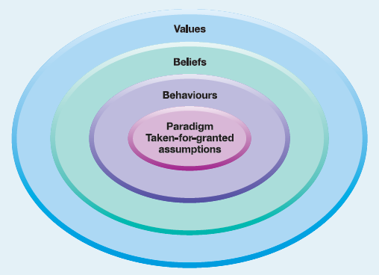
Culture
Basic assumptions and beliefs shared by members of an organisation, that operate unconsciously in a basic taken-for-granted fashion

Slide 19
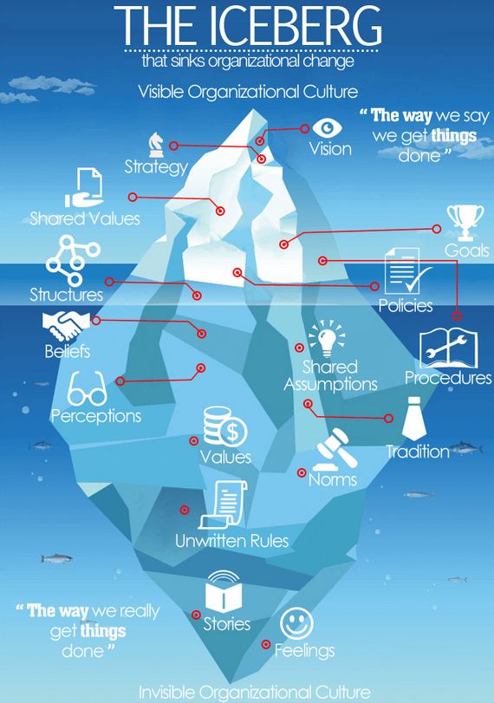
Culture
Torben Rick uses an iceberg analogy to show why organizational culture change sinks so many organisations.
At the top of the mass, there are visible indicators of a culture – but underneath is a bigger, invisible mass that holds all the ingrained cultural assumptions that are extremely difficult to affect.
Torben Rick puts it, the iceberg represents “the way we say we get things done” in contrast to the deeply-ingrained “way that things actually get done” within an organization.
http://www.visualcapitalist.com/iceberg-organizational-culture-change/

Slide 20

Evaluating Strategies

Slide 21
Evaluating strategies - performance
Assess performance
Economic performance
Organisational effectiveness
(current strategic position)
Evaluate options
Suitable
Acceptable
Feasible
(implementation)
Identify gap
In evaluating an organisation’s strategic position, you will need to:
assess the performance of the organisation
identify gaps
evaluate identified options for suitability, acceptability and feasibility.
write a new strategy
Notes:
Further reading: Gerry Johnson, Richard Whittington, Duncan Angwin, Patrick Regner, Kevan Scholes (2014). Exploring Strategy Text & Cases. Part I The Strategic Position.

Slide 22
Evaluating strategies - performance
Assess performance
Economic performance
Organisational effectiveness
(current strategic position)
Evaluate options
Suitable
Acceptable
Feasible
(implementation)
Identify gap
After that, you need to work out if it is a realistic plan by considering: Performance: do I have the people/capacity within my business to do what I propose?
Finance: can I afford it – what investment is needed?
Time: have I got the time to do it? Is the time I’ve allowed realistic?
Notes:
Further reading: Gerry Johnson, Richard Whittington, Duncan Angwin, Patrick Regner, Kevan Scholes (2014). Exploring Strategy Text & Cases. Part I The Strategic Position.

Slide 23
Is it realistic?
3
There will always be an element of risk in a strategy (it might not work) and when you assess the strategy, the risk will move towards the factor which is problematic.
For example (in this figure), if you don’t have time to carry out everything that is required, then TIME will be highlighted as a risky area.
Time (speed or certainty)
A
B
Risk
Cost
(price or certainty)
C
Performance
(design, quality, functionality)
2
1

Slide 24
Tools and Techniques
Many tools and techniques exist which can be used for evaluating strategic position
Certain tools are more appropriate for certain aspects, e.g.
Purpose
Environment
Capability
Culture
SWOT
PESTLE
Benchmarking
Focus Groups

Slide 25
Activity 4 Using Strategic Tools
Split into FOUR groups
Complete the task on your hand-out
Moodle: watch video clip of xxx
00.35 - 03.46

Slide 26
Points for Discussion - using tools
One size does NOT fit all!
Your choice to tool depends on the particular scenario you are dealing with
Carrying out the test is not enough!
Your must apply the findings directly to your company

Slide 27
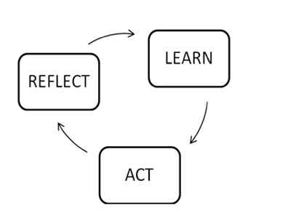
End of Workshop Reflection
What have I learned today?
- list 3 points
How can I apply my learning to my own professional practice?

Slide 28

Next steps…
Today’s workshop has introduced a number of key concepts
You must follow this up with Learning Journey 2
You should study the material in more depth and apply it to your assessment task

Slide 29
Points to Remember
Complete the online learning journeys
View the Employer Scenarios
Choose ONE scenario to focus on for your assessment
Assignment hand in date: xxx

Slide 30
Summary
At the end of this workshop, you should be able to:
Discuss the module structure and content
Understand the assessment requirements
Discuss the role of a consultant
Understand the factors involved in strategic positioning
Consider the value and appropriate use of key strategic tools

Slide 31
References
Johnson, G., et al., (2017) Exploring Strategy; Text and Cases, 11th ed., Edinburgh: Pearson Education Limited
Kelly, P., (2009) International Business and Management. Hampshire: Cengage Learning EMEA,
Langford, D., and Male, S. (2008) Strategic management in construction. John Wiley & Sons
Torben Rick, http://www.visualcapitalist.com/iceberg-organizational-culture-change/

